Slide 1
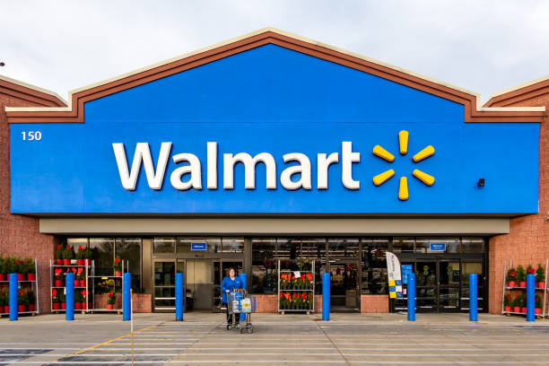
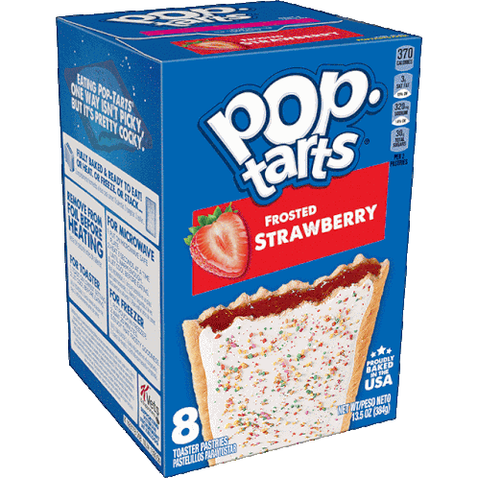

Walmart Hurricane Analysis
Noor Imat, Angela Benedict, Aubin Barcheck, and Nico Roppatte
Notes:
IMPORTANT: Please go through this presentation in presentation mode and then read the speakers notes because some slides require clicking to reveal code/tables. Thank you!

Slide 2
The Issue: Are Strawberry Pop-Tart Sales Related to Approaching Hurricanes?
Dates came in 5 different formats; only 2,511 of 25,562 rows were read correctly at first
45 SKUs for only 20 real products (Strawberry Pop-Tarts were split across 4)
4,345 store IDs and 3,026 prices were in the wrong format
Notes:
Before any analysis, the data had three big problems: mixed date formats, split SKUs, and badly formatted IDs and prices. If we hadn’t fixed these, our numbers would have been wrong.

Slide 3
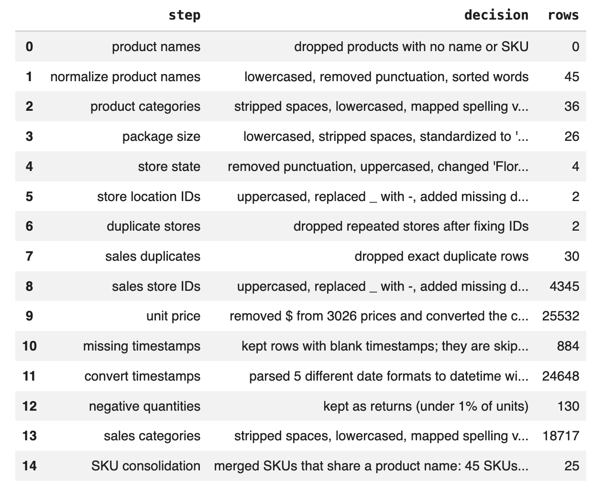
Data Cleaning and Joining
Decision Log
Step, decision, and rows affected:
Cleaning:
Cleaned all provided data following this decision log
Dropped a total of 32 rows by dropping duplicates
  Ended with 25,532 rows for sales
Kept rows containing missing timestamps:
  Product and quantity columns in these rows are still valuable
    Help calculate total number of units sold per category
  Doesn’t impact surge multiple because get skipped
Kept rows containing negative quantities:
  Dropping them barely changes data (accounts for 1%)
Notes:
We cleaned all the files in one pipeline and logged every step with how many rows it changed. We kept missing timestamps and negative quantities, since dropping them would lose real sales or barely change anything.

Slide 4
Data Cleaning and Joining
Joining:
Left join of Orlando daily weather (Open-Meteo, Eastern time) onto daily sales by date
Sales rows before: 30, after: 30
Missing weather values: 0 (wind, rain, and pressure)
Decision: left join instead of inner, so no sales day could be silently dropped. If landfall day (Sept 26) were missing weather, an inner join would remove the most important day.
Notes:
We joined Orlando weather onto daily sales by date with a left join, so no sales day could be dropped. All 30 days matched, with no missing weather values.

Slide 5

Question 1
Which product categories experienced the greatest sales surge in the 7 days before hurricane landfall compared to the prior baseline period? Quantify the percentage increase and visualize the daily trend for the top 5 categories.
Notes:
Q1 asked which categories surged the most in the week before landfall.

Slide 6
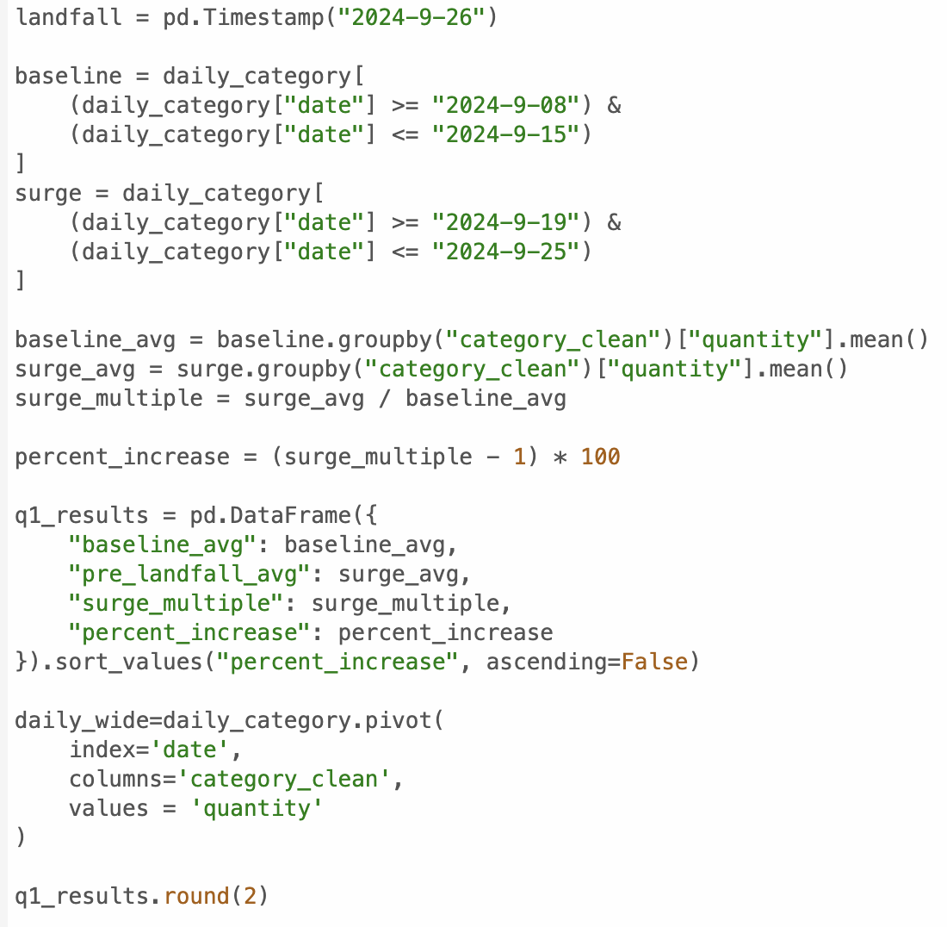
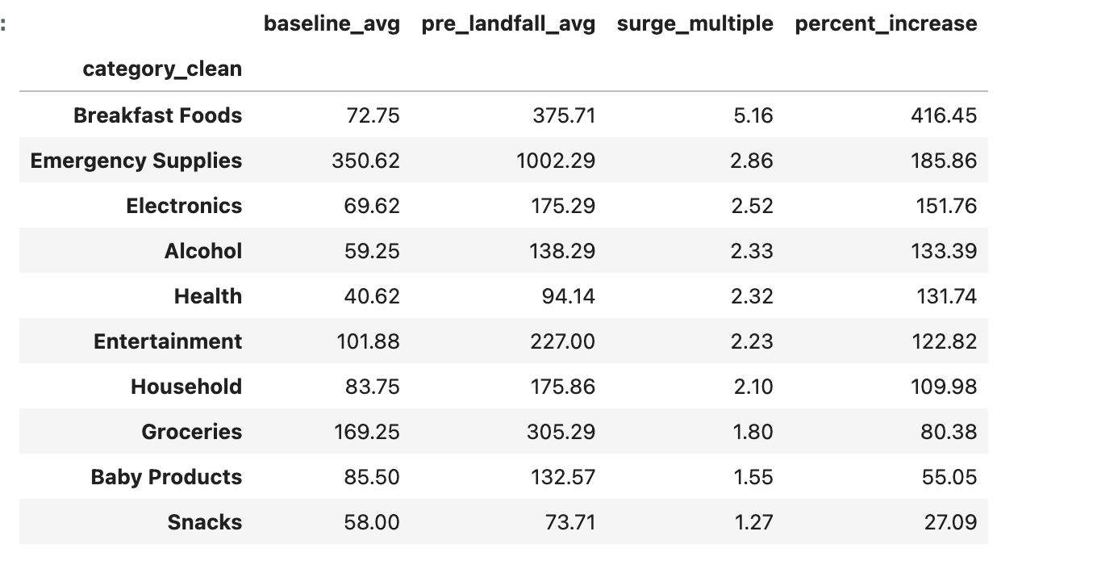
Question 1: Baseline/Surge periods
Found and established landfall date
  Sept 26th, 2024
Created baseline period (normal numbers)
  Sept 8th - Sept 15th, 2024
Created surge period (when customers should be buying before storm)
  Sept 19th - Sept 25th, 2024
Calculate baseline and surge averages
  Used to calculate surge multiple
    Used to calculate % increase
Put these into new dataframe and display results
Notes:
#Please view this slide in presentation mode first then read the speaker notes!
Our numbers show us that Breakfast foods experienced the biggest spike with a surge multiple of 5.16 and a percent increase of 416.45%. We need to now visualize this so that it’s easier for the Walmart manager to understand.

Slide 7
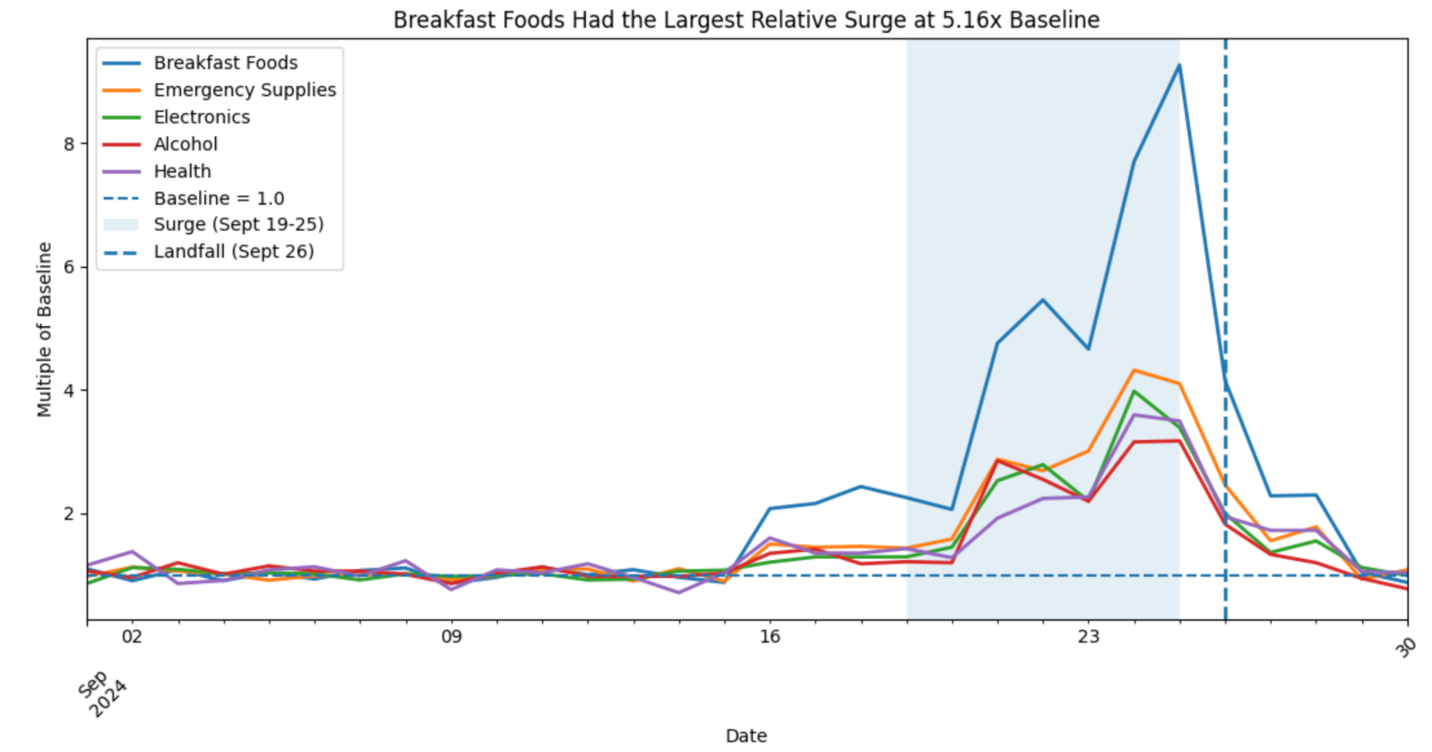
Question 1: Visualization of surge for top 5 categories
Breakfast foods show the largest spike with a surge of 5.16 times the baseline
Notes:
Graph 1 illustrates the daily trend for the top 5 product categories that experienced sale surges before hurricane landfall. The x axis is the date ranging only in September, 2024, and the y axis is the surge multiple (by how many times more each category sold during surge vs baseline). The blue highlighed region from Sept 19th-Sept 25th shows the surge period, and the vertical dotted line on Sept 26th represents the hurricane landfall date. Each colored line represents a different product category and it's varying surge multiple over time, with Breakfast Foods demonstrating the highest spike with a surge multiple of 5.16x the baseline (416% increase).

Slide 8
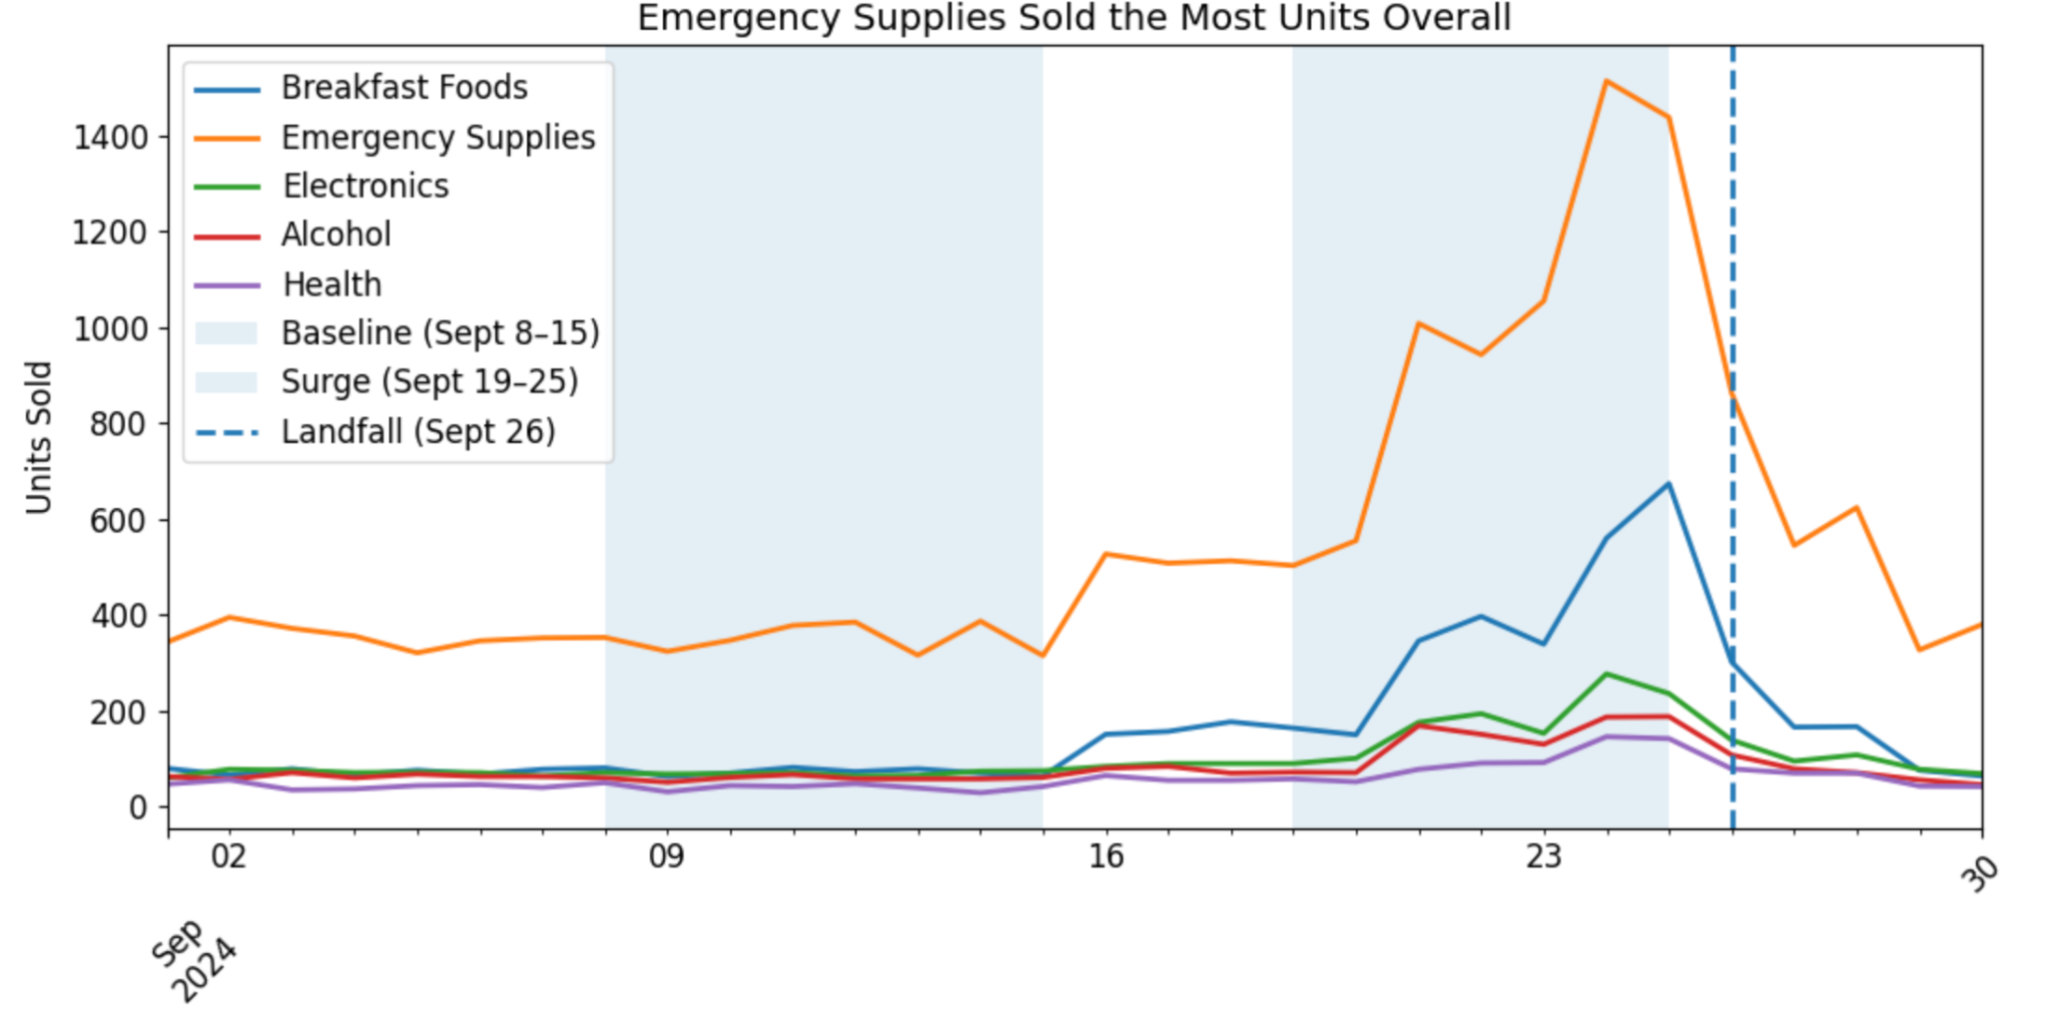
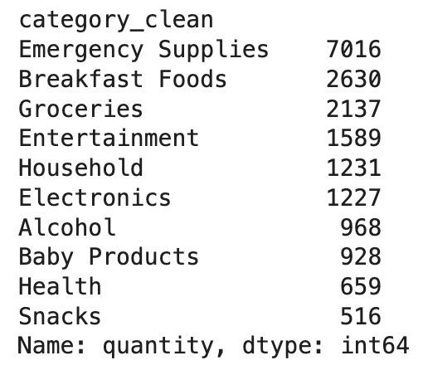
Question 1: Visualization of units sold for top 5 categories
Units sold:
Date
Emergency Supplies category sold the most units (7,016 units)
Notes:
Graph 2 shows how many units were sold from each category of products over time in September, 2024. Each colored line represents an individual category, with the x axis being the date in September and the y axis being the number of units sold. The graph displays that more units were sold in the Emergency Supplies category than any other category, with Breakfast Foods following next.

Slide 9
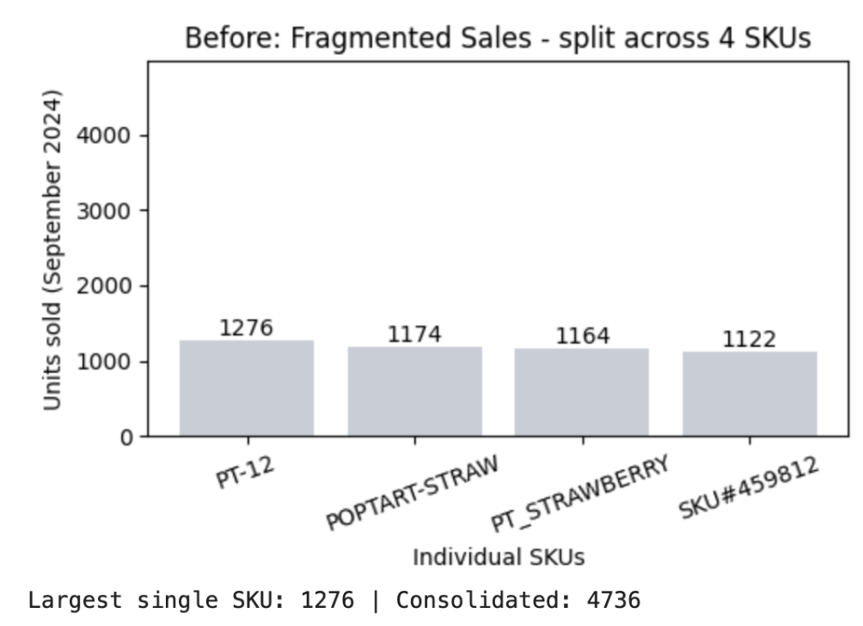
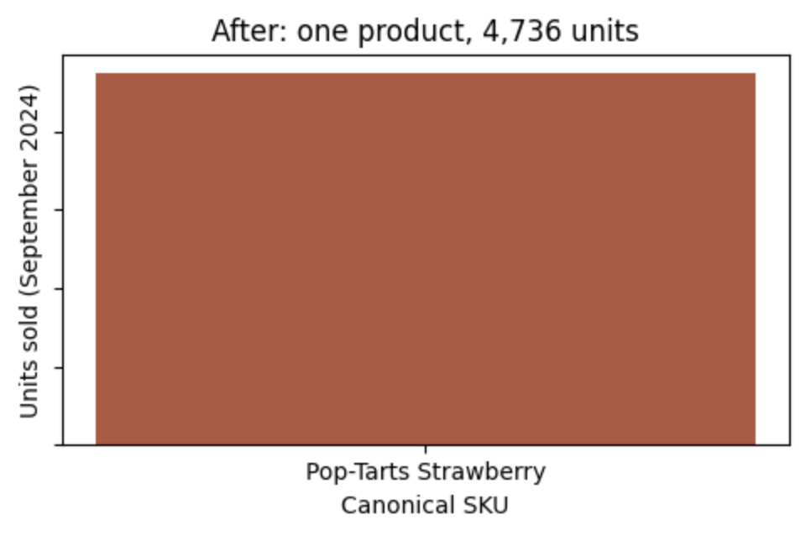
Question 2
Consolidated Pop-Tarts sales are 3.8x bigger than the largest single SKU shows
After standardizing all Pop-Tart SKU variants into a single product, what is the true daily sales volume? How does the uncleaned (fragmented) view compare to the cleaned (consolidated) view? What business decisions would differ between the two views?
Notes:
First we grouped SKUs by looking at where product names overlapped but were appearing with different SKU values. From here we combined them under one SKU for each product type, the canonical SKU. This is important because it helps provide better data and analysis since we can see the true sales of Strawberry Poptarts instead of 4 separate products with 4 different SKUs that make the numbers seem much lower than they should. By combining SKUs, we can see the true inventory and sales impact of each product. This continued for the second part where we were able to better visualize the daily sales volume for strawberry poptarts because now we could see the total sold versus the fragmented SKUs which caused underestimates of the poptarts popularity.

Slide 10
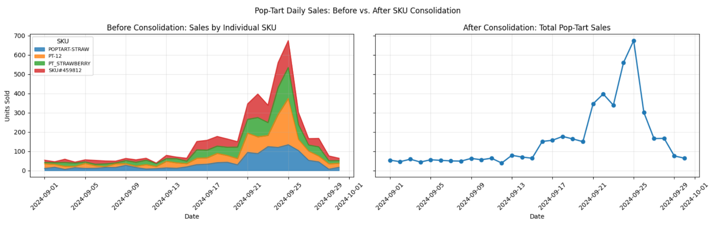
Question 2: Visualizations
Fragmented SKUs made true daily sales volume small, but when consolidated, they show a large number of Strawberry Pop-Tart sales, especially surrounding the hurricane timeline.
Notes:
I found this by looking where SKUs seemed to have similar products associated with them, despite having distinct SKUs. From this I was able to turn 45 distinct SKUs into 20 canonical ones which allowed for greater analysis of sales trends.
Fragmented SKUs returned low sales number for the month of September with each SKU only ranging from about 1100 - 1300 in units sold, make the products seem average or underwhelming when determining where to focus restock efforts. However, this split hid just how successful Strawberry Pop-Tarts were in sales, especially around the storm time. Not only were 4,736 units of Strawberry Pop-Tarts sold in the month of September when you look at the consolidated SKU, but 1,234 of those units were from the combination of September 24th and 25th sales which was the peak before storm landfall. This would make it seem that 26% of sales in the month could be attributed to the storm.
Overall, fragmented SKUs underplayed just how many Strawberry Pop-Tarts were being bought, and by consolidating them into one cohesive SKU, we can get a more in depth analysis of the product.

Slide 11

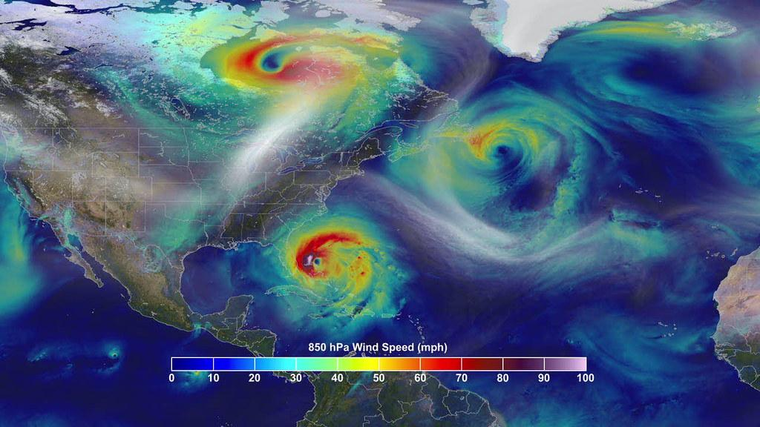
Question 3
Using weather data pulled from your chosen free API, how do specific weather indicators (wind speed, precipitation, barometric pressure) correlate with daily sales volume across categories? Is there a detectable lag between weather severity escalation and purchasing spikes?
Notes:
Q3 asked whether weather (wind, rain, pressure) lines up with sales, and whether people buy before the storm gets bad.

Slide 12
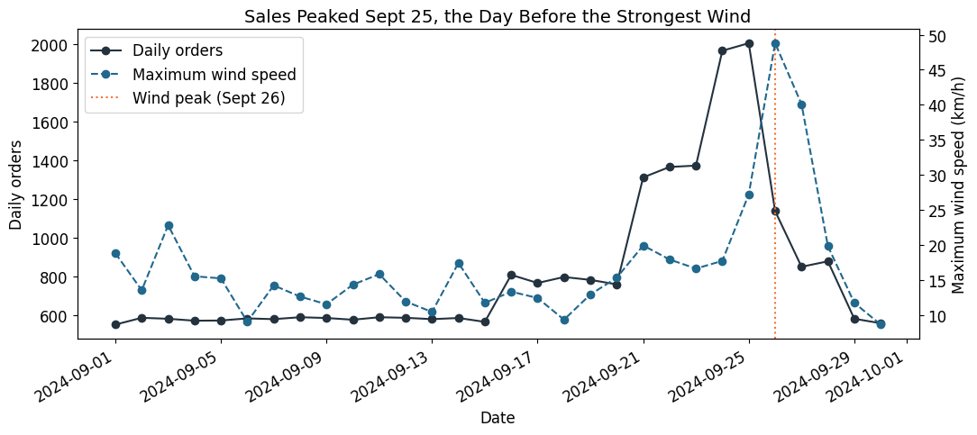
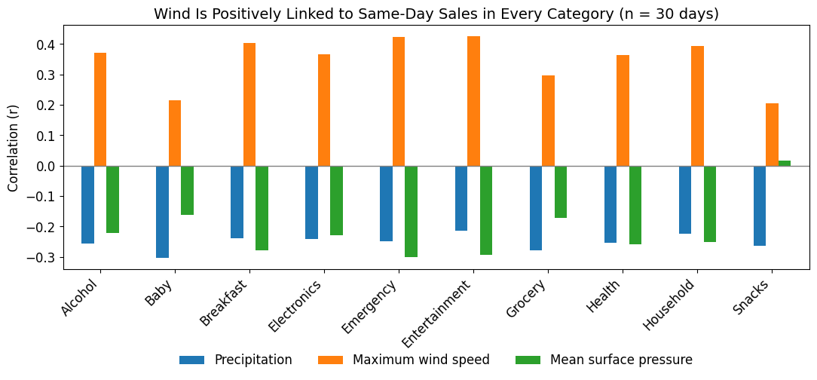
Question 3: Weather Correlation/Visualizations
Sales Peaked Before the Storm
Pulled Orlando weather from the Open-Meteo API (Eastern time) and joined it to daily sales: 30 days, no rows lost
Same day: wind r=0.39, rain r=-0.25, pressure r=-0.26
Sales peaked Sept 25, one day before the strongest wind on Sept 26 (landfall)
With a 2-day lag, the wind correlation jumps to r=0.82
The peaks are 1 day apart, but the buying build-up started 2 days ahead of the wind
Notes:
Same-day wind only had a moderate link with sales, 0.39, but shifting it two days gave 0.82. So people stocked up before the storm hit, not during it.

Slide 13

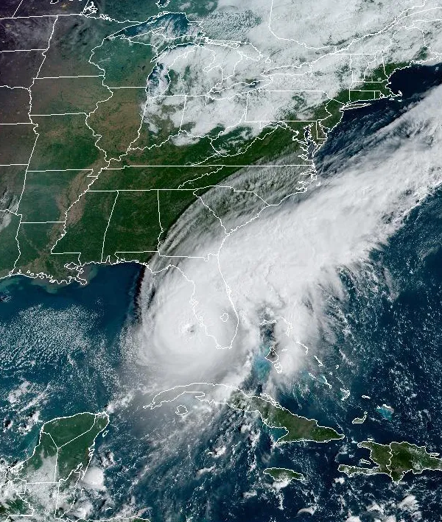
Question 4
Store-Level Geographic Patterns
Do all Florida store locations experience the same surge patterns, or do stores closer to the predicted hurricane path show earlier and larger spikes? Identify any stores that appear to be outliers.
Notes:
Q4 asks what surge patterns appear and if they are related to the hurricane’s path.

Slide 14
Question 4: Store-Level Geographic Patterns
Surge Multiples
Calculated each store's average sales during the baseline and the surge periods.
  Baseline: Sept 8th - Sept 15th, 2024
  Surge: Sept 19th - Sept 25th, 2024
Compared sales between the two periods to calculate each store's surge multiple.
Added each store's location and region to the results.
Calculated the distance from each store to the storm's landfall.
  Landfall coordinates: latitude 30.0 and longitude -83.7
Grouped stores by region and calculated their average surge multiple and distance.
Notes:
We calculated each Florida store's surge multiple by comparing its average daily sales during the seven-day period before the storm (Sept. 19–25) against the baseline week (Sept. 8–15). We then joined the results with store location data, including latitude, longitude, and region, and calculated each store's distance from the storm's landfall using the Haversine formula. Since FL-619 had missing coordinates, we used the general coordinates of its town, Tallahassee (latitude 30.4383, longitude -84.2807), as an estimate. Finally, we created two scatterplots: one comparing surge multiples and distance for individual stores, and another comparing average surge multiples and distance across regions.

Slide 15
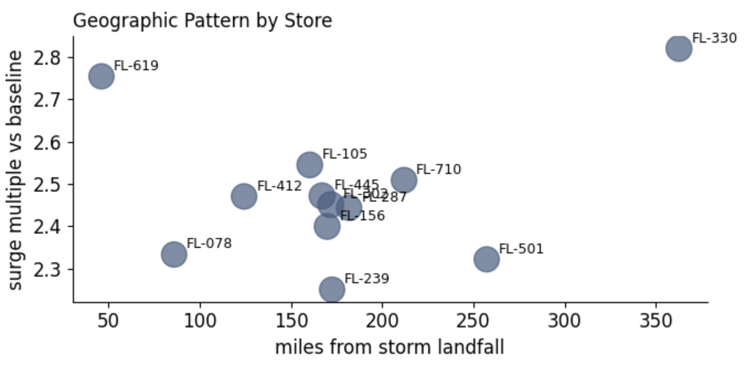
Question 4: Store-Level Geographic Patterns
Visualizations
There appears not to be a strong correlation between store distance from landfall and surge multiple
Notes:
The scatter plot uses the x-axis to show each store's distance from storm landfall in miles and the y-axis to show its sales surge multiple compared to baseline. Each dot represents an individual store, with larger dots indicating more total transactions. This visualization allows us to compare how sales surges varied based on each store's distance from the storm.
We would expect stores closer to the predicted hurricane path to experience larger sales surges as customers prepare for the storm. However, the results do not consistently follow this pattern. FL-330 is the clearest outlier, experiencing the highest surge (2.82× baseline) despite being the farthest store from landfall at 362.8 miles. Meanwhile, FL-619, the closest store, had the second-highest surge. This suggests that distance from the storm was not the only factor influencing customer purchasing behavior.

Slide 16
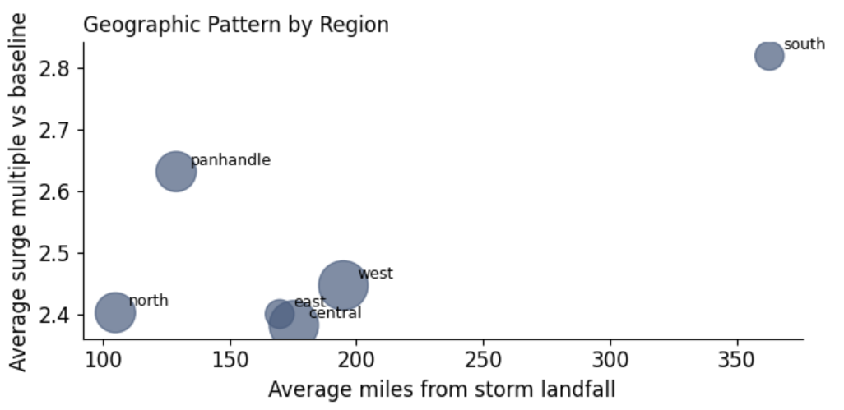
Question 4: Store-Level Geographic Patterns
Visualizations
There appears not to be a strong correlation between region and surge multiple
Notes:
The regional scatter plot uses the x-axis to show each region's average distance from storm landfall and the y-axis to show its average sales surge multiple compared to baseline. Each dot represents an entire region, with larger dots indicating more total transactions across its stores. This visualization allows us to compare sales surges and geographic patterns across Florida's regions.
The regional results show that sales surges varied across Florida, even though the storm made landfall in the Panhandle. The Panhandle was relatively close to landfall, but it did not have the highest average sales surge. Other regions farther away experienced comparable or larger increases, with the South region standing out as an outlier because it experienced a particularly strong surge despite being much farther from landfall. Overall, proximity to landfall did not consistently predict the size of regional sales surges.
Stores closer to the storm's landfall did not consistently experience larger sales surges. All regions experienced substantial increases in sales during the pre-landfall period, with surge multiples ranging from 2.25× to 2.82× their baseline averages (a 125.03%–182.03% increase). The South region experienced the strongest average sales surge, making it an outlier because it was the farthest region from landfall. In contrast, the Panhandle region was expected to have the greatest surge because it was closest to the storm's landfall. However, the results showed that proximity to landfall did not consistently predict the size of regional sales increases.
This suggests that proximity may have contributed to stronger demand at some locations, but distance alone does not explain the differences in sales patterns.

Slide 17
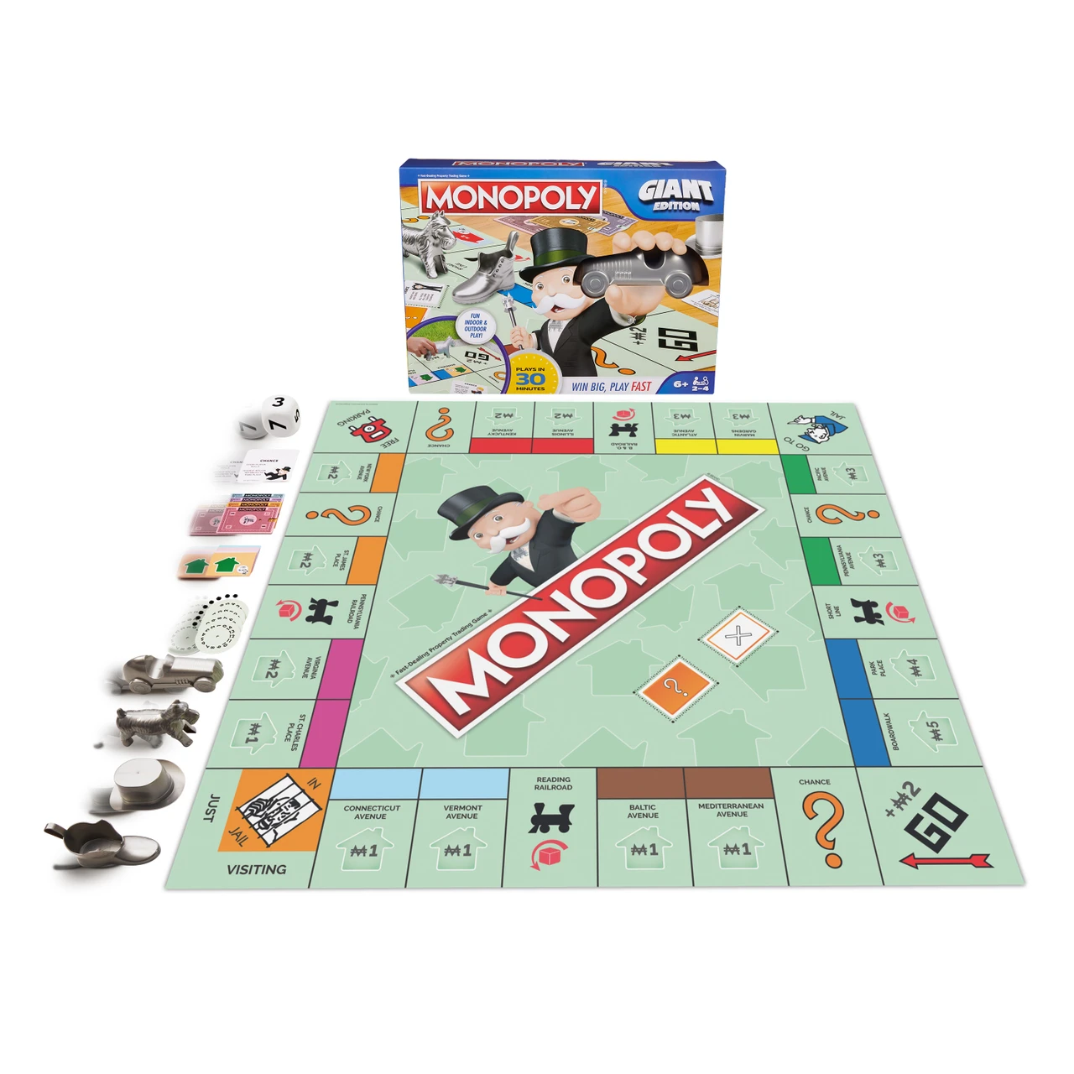
Question 5
The board games/entertainment category shows a +250% sales increase. Using the SQLite inventory and sales database, investigate whether this is a genuine demand signal or a data artifact (e.g., SKU miscoding, category lumping, inventory reporting lag). Present your evidence and make a recommendation: should Walmart stock extra board games for the next storm?
Notes:
Q5 asked whether the +250% board game spike was real demand or a data mistake.

Slide 18
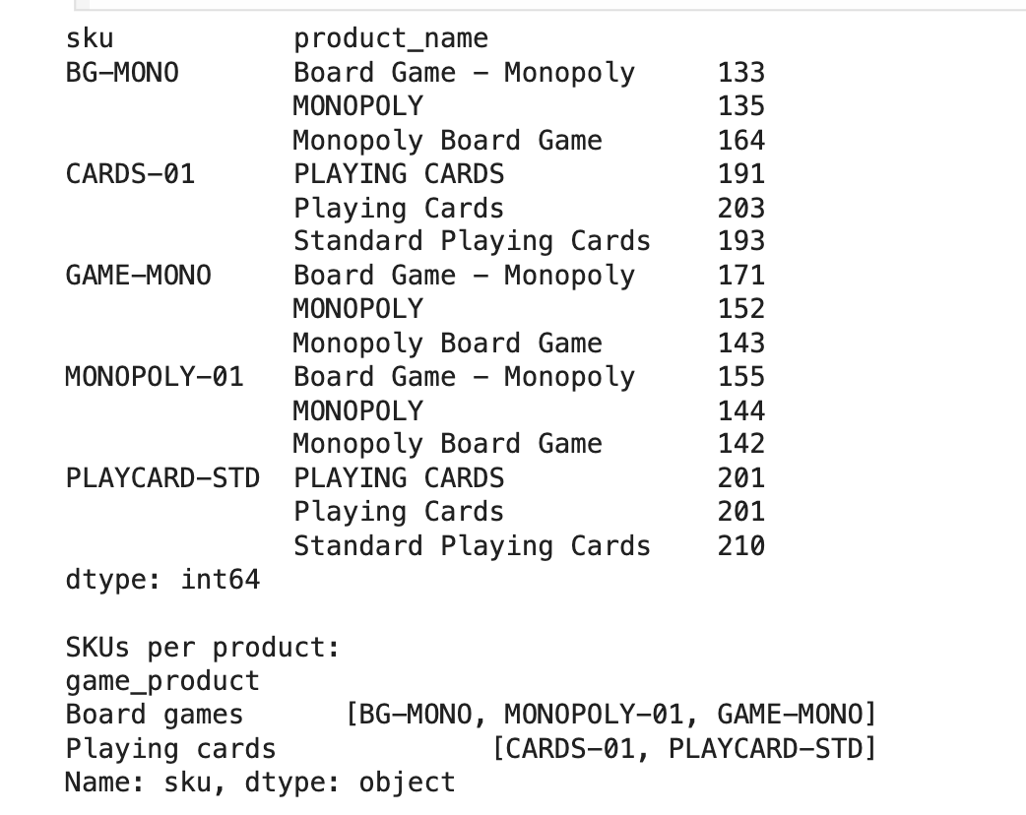
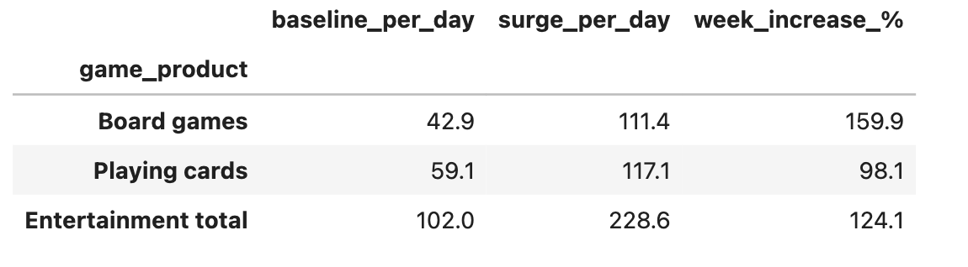
Question 5: Board Game Investigation
SKUs
Consolidated SKUs into 2 products in Entertainment:
Board games
  Increased by +160%
Playing cards
  Increased by +98%
4 SKUs were found in the inventory that are never part of any sale (UNKNOWN-99, MISC-001, LEGACY-PT, OLD-BATT-50)
  There is no link between those and board games
Notes:
Explanation of what we did: We imported the daily_sales_summary and inventory_levels tables from the SQLite database and the transactions file as well. First, we investigated what is present in the Entertainment category and found out there are just two items within: Monopoly (3 SKUs) and playing cards (2 SKUs); therefore, we grouped all these SKUs. Then we analyzed the seven-day period before the storm (Sept 19-25) vs. the baseline week (Sept 8-15) and the single peak day as well. Furthermore, we divided the Entertainment category into board games and playing cards, investigated if the store inventory decreased during the spike and investigated SKUs not present in sales but present in the inventory table.

Slide 19
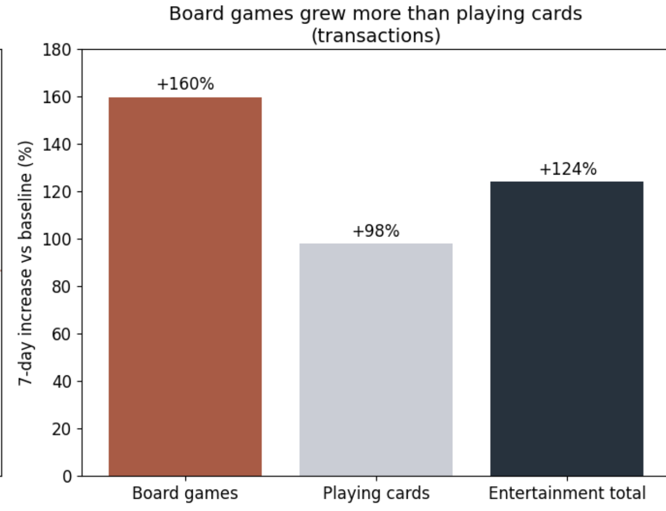
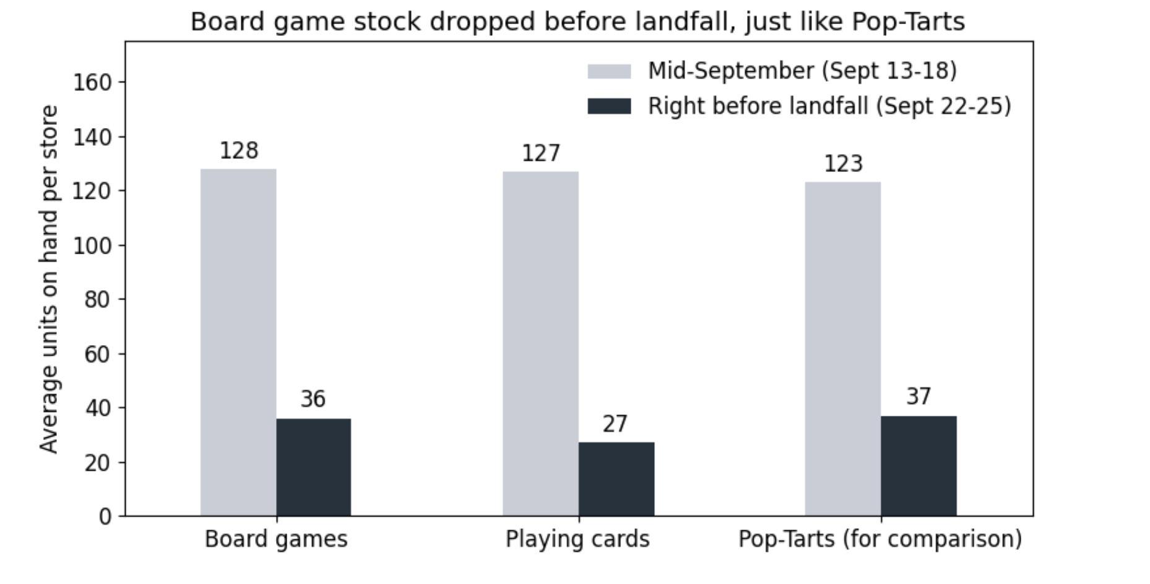
Question 5: Board Game Investigation
Board Games VS Poptarts
Board games grew more than playing cards (+160% vs +98%)
Board game stock fell from ~128 to 36 units per store before the storm, just like Pop-Tarts (123 to 37)
  The spike seems to be driven by real consumer demand and not by mistake
Notes:
Board game stock fell from about 128 to 36 per store before the storm, the same pattern as Pop-Tarts, so people were actually buying them.

Slide 20
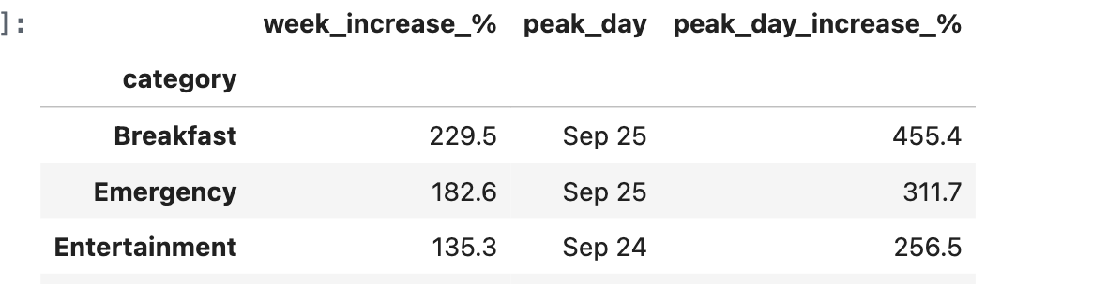
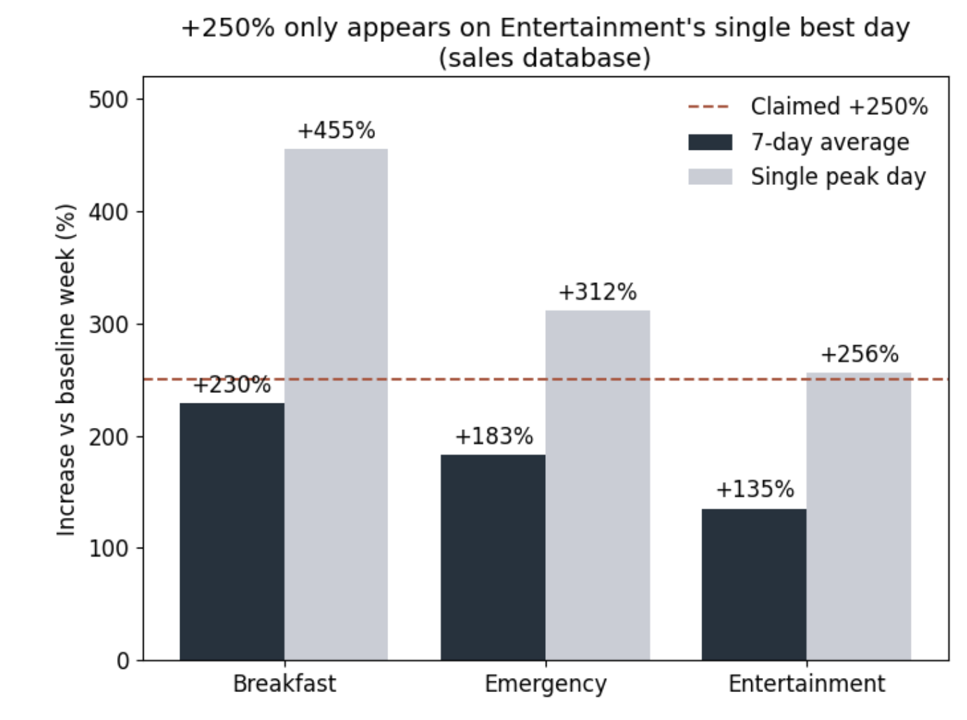
Question 5: Results
The board game spike is a reality, but +250% is overstated.
  Entertainment only reached +256% on a single day (Sept 24).
On average over 7 days before the storm, entertainment grew by +135%, which is lower compared to Breakfast (+230%) and Emergency Supplies (+183%)
Notes:
The +250% only happened on one day. Over the full week, entertainment grew 135%, which is less than Breakfast and Emergency Supplies.

Slide 21
Question 5: Recommendation for Walmart
It is advised for Walmart to stock more board games for the next storm, planning for about double the normal sales instead of 3.5 times, but not taking truck space from Breakfast and Emergency Supplies, which increased more.
Reason: Entertainment grew +135% (about 2.35x normal), and the one-day +250% (3.5x) overstates it. We rounded down to 2x to stay cautious
Notes:
So Walmart should stock about double the usual board games, but only after essentials like Breakfast and Emergency Supplies are covered. Should also be cautious about this since this data is collected from only 1 storm and may not be reliable enough to make a drastic stock supply change.

Slide 22
Overall Recommendation
Stock up a full week before landfall: buying started climbing around Sept 19–21 and peaked the day before the storm
Prioritize Breakfast Foods and Emergency Supplies: Breakfast grew the most (5.16x), Emergency sold the most units (7,016 in the surge week)
Track Pop-Tarts as one product: split SKUs hid 3.8x the real demand
Board games: about 2x normal, only after essentials: cautious, since it’s based on one storm
Notes:
Overall, Walmart should start stocking a week before landfall, put Breakfast and Emergency Supplies first, track products by one SKU so demand isn’t hidden and add a cautious amount of board games after essentials.

Slide 23
What Broke
We struggled the most with the timestamp parse in the pipeline
Read timestamps without format=”mixed”, so pandas only understood 1 of the 5 date formats
  Cut our dataset from 25,562 rows to 2,511 without us knowing, making our sales figure for Q1 10 times smaller
  Easy to not notice because Breakfast Foods stayed top category
We learned to validate row counts after each step to identify and prevent any silent row drops
Notes:
Our biggest problem was the dates. Without format='mixed', most dates silently disappeared, so now we check row counts after every step

